Slide 1
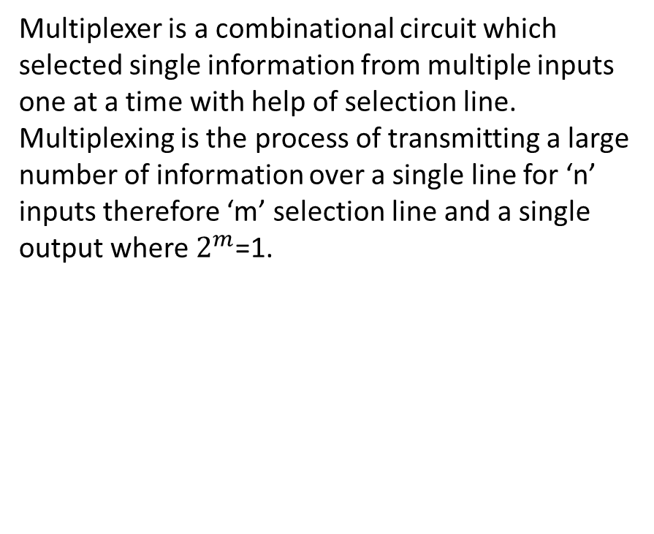
Multiplexer
Multiplexer is a combinational circuit which selected single information from multiple inputs one at a time with help of selection line. Multiplexing is the process of transmitting a large number of information over a single line for ‘n’ inputs therefore ‘m’ selection line and a single output where $2^{m}$=1.

Slide 2
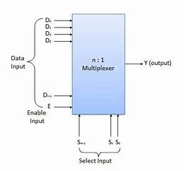
Figure of Multiplexer

Slide 3
Multiplexers are used in data routing application to rout the data in sequence and particular directions well as destination as a single output from several input signals.
It is used as logic function generator where logical expression (Boolean algebraic functions) can be generated instead of logic gates.
MUX can be also used to convert the parallel data in serial data. Parallel to serial conversion is needed in measurement. Testing, military, aerospace data communication and telecommunication.

Slide 4
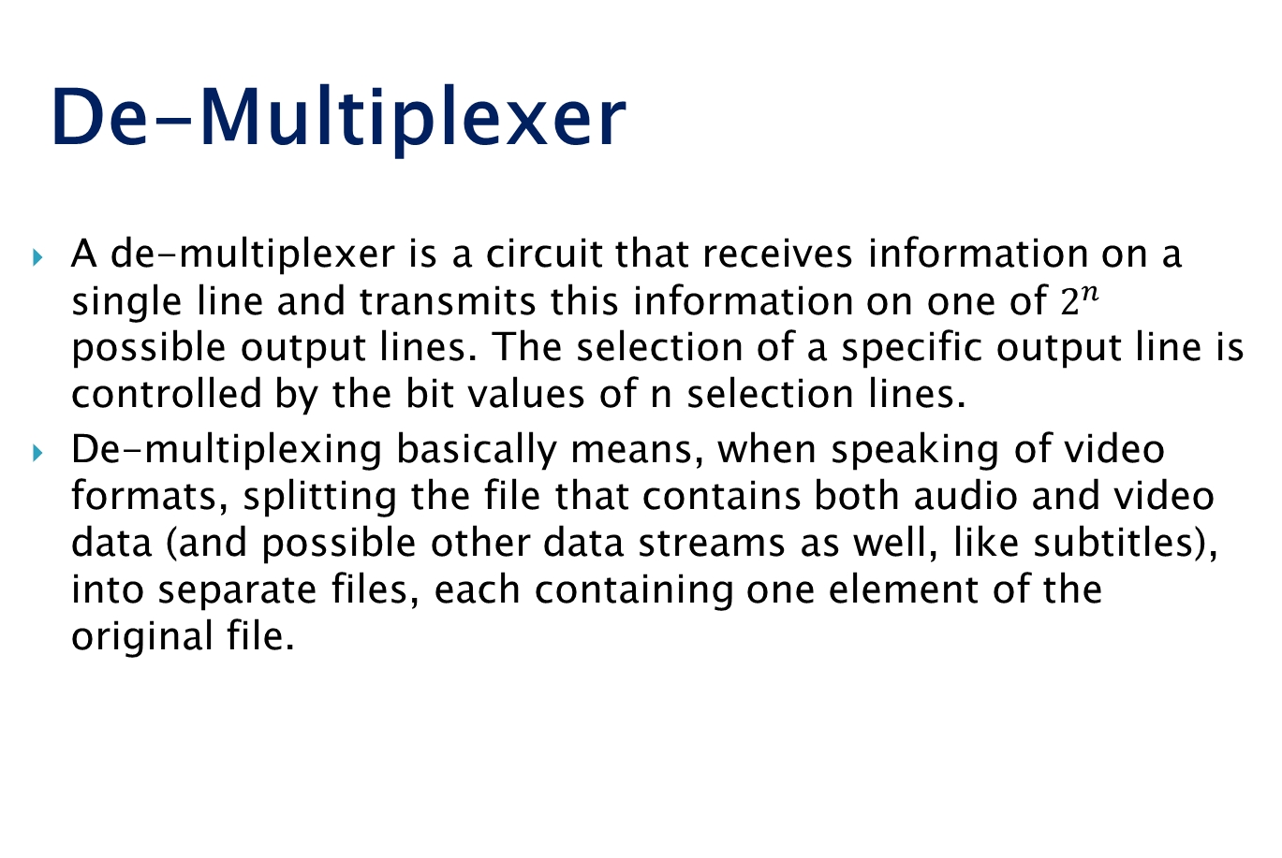
De-Multiplexer
A de-multiplexer is a circuit that receives information on a single line and transmits this information on one of $2^{n}$ possible output lines. The selection of a specific output line is controlled by the bit values of n selection lines.
De-multiplexing basically means, when speaking of video formats, splitting the file that contains both audio and video data (and possible other data streams as well, like subtitles), into separate files, each containing one element of the original file.

Slide 5
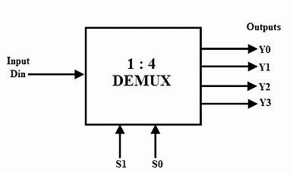

Slide 6
Parallel Adder
A single full adder performs an addition of two one bit numbers and input carry. But a parallel adder is a digital circuit that is greater than one bit in length by operating on corresponding pairs of bits in parallel. It consists of full adder connected in a chain where the output carry form each full adder is connected the carry input of the next high order full adder in chain.

Slide 7
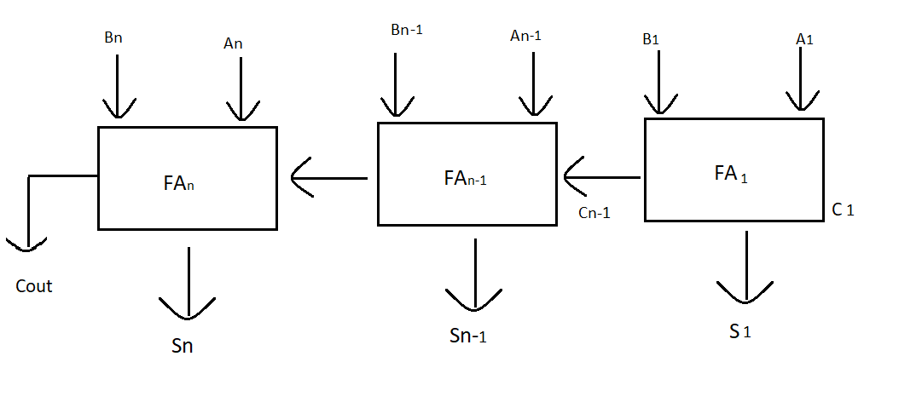
Figure of Parallel Adder

Slide 8
From the above figure the first adder fA1 adds the inputs bits a1 and b1 to produce sum s1 and carry c2 which is connected to the next full adder in chain.
Similarly next full adder also uses the carry bit c2 from the first adder to add with the input bits a2 and b2 to generate sum s2 and carry c3 which is connected to the next full adder and so on.
This process is continue till last full adder FAn uses the carry bit cn to add with input bit an and Bn to generate n output sum Sn with carry Cout.

Slide 9
Electronic Gates
Electronic gates are digital circuits that operate on one or more input signals to produce an output signal. Electrical signals or voltages exist throughout a digital system in either one of two recognizable values (bi-state 0 or 1).
Electronic gates are also known as digital circuits, switching circuits, logic circuits and gates. Gates are the basic building block of any digital system. In the electronic gates, the relationship between the input and output is based on certain logic. The voltage operated circuits respond to two separate voltages ranges that represents a binary variable equal to logic 1 or logic 0

Slide 10
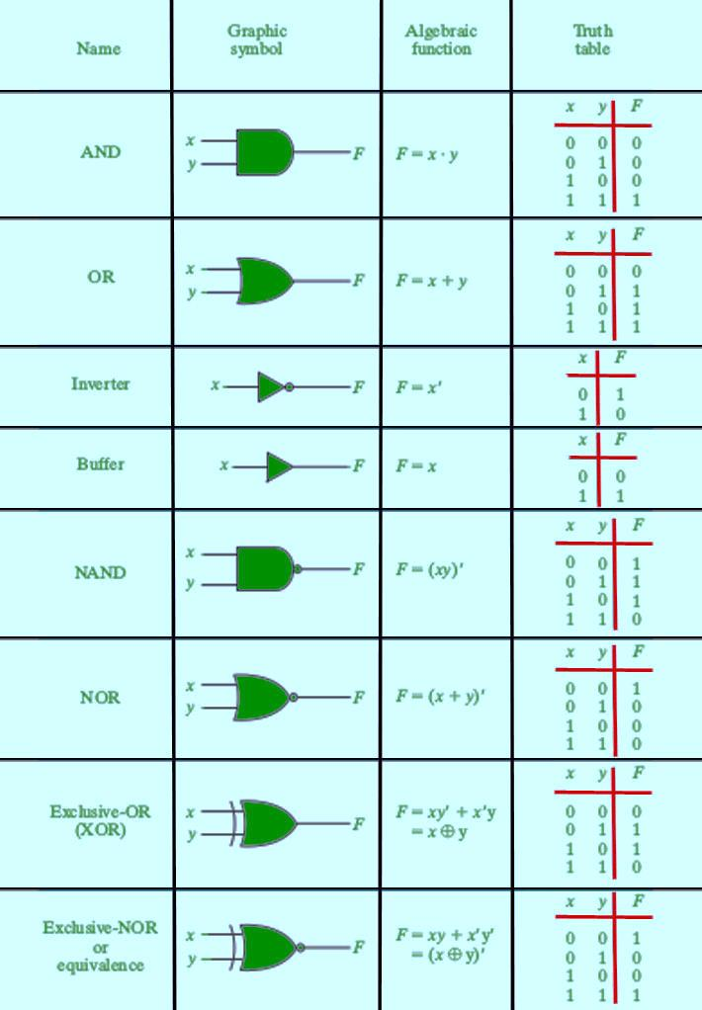
Figure of electronic gates

